Slide 1
Programming
Part 1
Armond R. Smith
Zhenying Wu

Slide 2
Overview of this Class
Transition from FTC -> FRC
Using Your Resources
Java Keywords
Data Types
Modifiers
Basic Structure
Understanding Logic
Reading / Writing Code
Object Oriented Programming
Motors, Servos, etc.

Slide 3
What this class is
In this class you will NOT learn how to write code.
This class is about learning how to read code and use your resources as a programmer
In order to go to advanced you need to take this class

Slide 4
Things that ARE NOT in FRC
#pragma is gone (YES!)
but you will set up your motors, servos etc differently
The “task” function does not exist
strings are easier to use

Slide 5
How is it The Same as FTC?
Logic does not change
Same Basic Structure (Data Types)
Still case sensitive
If you mess up one letters case (capitalization) you may not compile correctly.

Slide 6
How is it Different from FTC
FTC: Robot C ; FRC: JAVA
Larger Scale Robot = Larger Scale Coding
New Data Types
New Modifiers
“Object Oriented Programming”
Warning: You will have way more things to pay attention to and remember about your code.

Slide 7
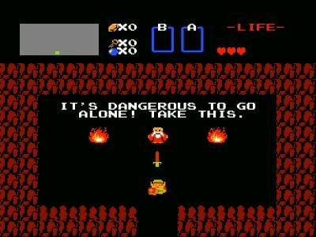
RESOURCES!

Slide 8
Resources you can use to help you
API/Libraries
Application Programming Interface: Your stock methods and functions.
Chief Delphi
Mentors
Your peers
Java for Dummies = Your New Bible

Slide 9
Things We Use Here
We use the IDE called “Netbeans”
For this presentation I'm using “Eclipse”
The main API we use is provided by FIRST
If you know how to, you can manipulate this infinite ways.
The API links us to the Drivers Station directly
You can learn to use it in part 2.

Slide 10
FTC Recap!
int -- Integer
boolean -- True or False
float -- Decimal
string -- “A string of text like this”
void -- returns no value
You can still use all of these in JAVA

Slide 11
New Data Types!
double -- decimal
More accurate than float
long -- decimal
More accurate than double (use for timing: Java uses nanoSeconds)

Slide 12
Basic Things
Comments
Does not affect the code!
“//” everything on the line after this will be a comment
“/* */” everything in between the asterisks will be comments
Semicolons (;)
Semicolons are line breaks. They are like periods in english.

Slide 13
Starting Up
task main
public static void main(String[] args)
What does this mean you ask?
Lets Break it down

Slide 14
public static void main(String[] args)
public -- The method can be seen by other files outside of the package (folder)
static -- The method is global; there can only be one of this method
void -- it returns no value
main -- is the first method looked at by the code
String[] args -- Just accept that it exists, you don't have to worry about it, just remember it when you code.

Slide 15
Hello World
Create new class file called “HelloWorld”
In the class, make public static void main (String[] args) method
In that method put in “System.out.println(“Hello, world”)”
This code prints in the console “Hello World” and then ends the code.

Slide 16
Modifiers: What is a modifier?
“public” and “static” are examples of Modifiers
Modifiers edit the type of a variable or method.
Can change visibility of variables to other variables
Can change how variables interact with each other
There are others out there (covered in pt. 2)

Slide 17
Statements & Logic Gates
“if” statements and “else if”
if(condition){/* do something */}
else if (condition){/* do something else*/}
“while” loops
while(condition){/* do something */}
“for” loops
switch cases
et al.

Slide 18
Statements & Logic Gates (contd.)
|| → two vertical bars means “or”
&& → two ampersands means “and”
== → two equal signs converts int to boolean
( x = 2 ) = true
! → any exclamation point means “not”
>= or <= → greater/less than or equal to
+= or -= → add to the left side by the right side
x += 20 (add 20 to x)
++ or -- → add one to the left side

Slide 19
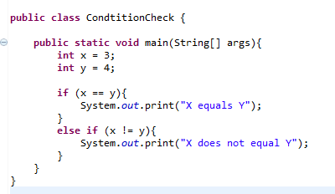
Math Time!
You will be using conditionals and paying attention to variables a lot!
Learning how to read the code is the first step to actually coding.
The Class below shows some ways of creating variables and checking conditions.

Slide 20
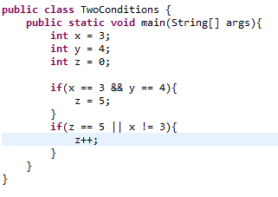
Two Conditions
Look at the code below
What will z equal (as shown in the code below)?
What will z equal if you change the value of x only?
What will z equal if you change the value of y only?
What will z equal if you change both x and y?
Answers:
z = 6
z = 1
z = 0
z = 1

Slide 21
Yes, Reading the Code is difficult!
When you read code you have to constantly refer to other parts of the code
You must have some kind of method to reading code
To ease it up for readers, make sure you write your code so that it is readable

Slide 22
Writing code so others can read it.
Name variables well!
If it confuses you, it may confuse someone else.
Casing
Can easily differentiate types of variables
Constants are normally all caps (CONSTANT)
Camel Casing for variables (camelCasingVariable)
Spacing
Have it so that your code is easy on the eyes

Slide 23
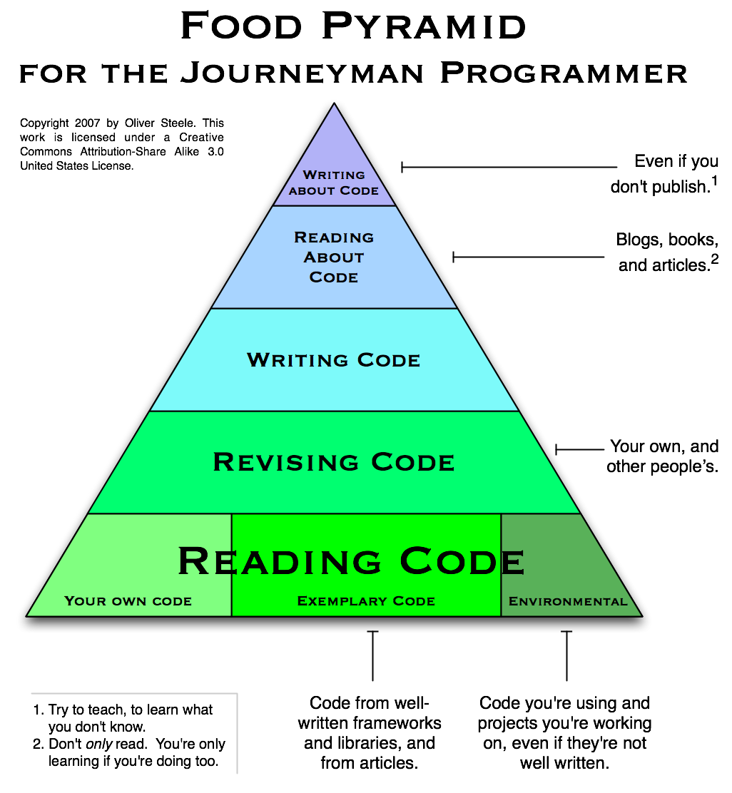

Slide 24
So What does some of our code look like?

Slide 25
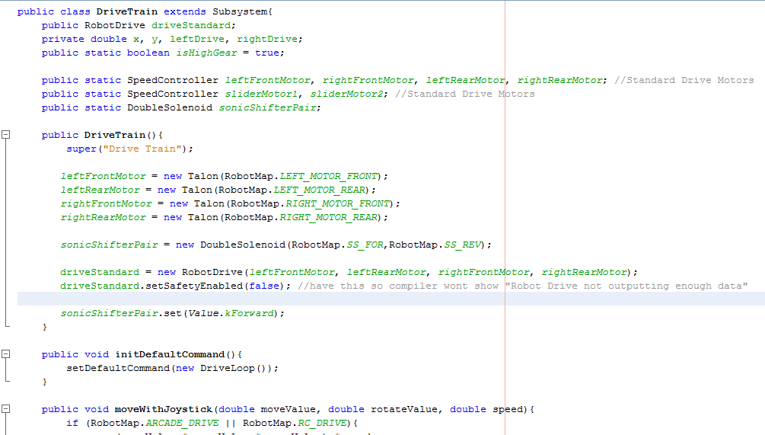

Slide 26
Reading The Code
Even though you don't know what that means, you can read it and sort of understand what it means.
You know what each variable is based on the name.
You will learn how structure works in pt 2.

Slide 27
Wrap Up
In programming, everything is present at the same time
It looks scary, but with practice you will understand more.
The best way to program is to first learn what resources you have.
The API is your friend.

